Slide 1
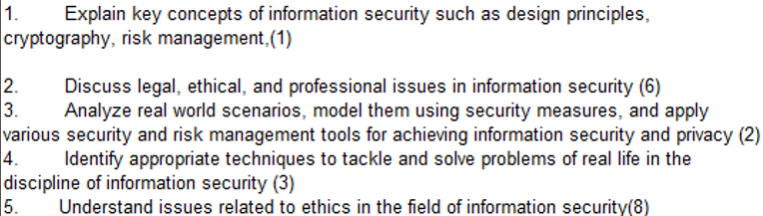
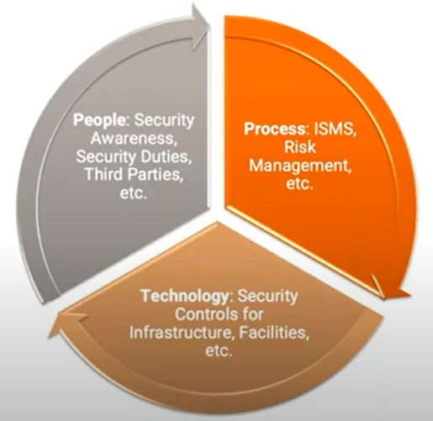
CS 3002 Information Security
Fall 2023
Week # 7
Dr. Nadeem Kafi Khan

Slide 2
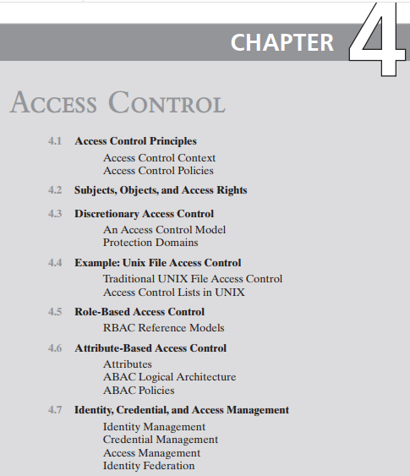
Access Control Principles
Subjects, Objects and Access rights
Discretionary Access Control
Self reading…part of syllabus.
Unix File Access Control
Role Based Access Control (Lab)
Attribute Based Access Control (Lab)

Slide 3
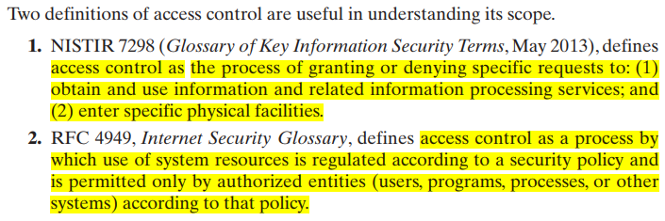

Slide 4
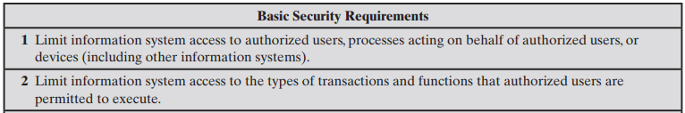

Slide 5
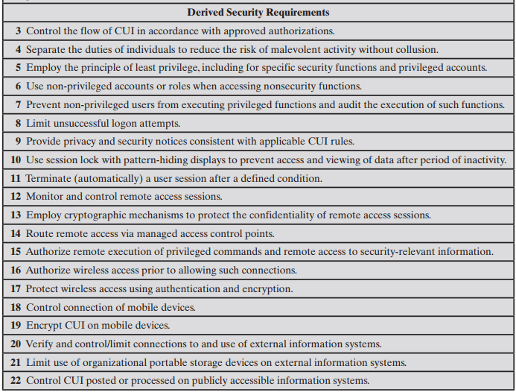
CUI = controlled unclassified information

Slide 6
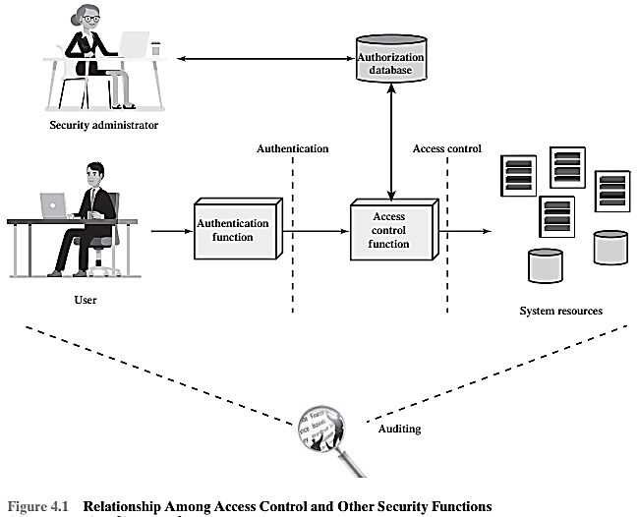

Slide 7
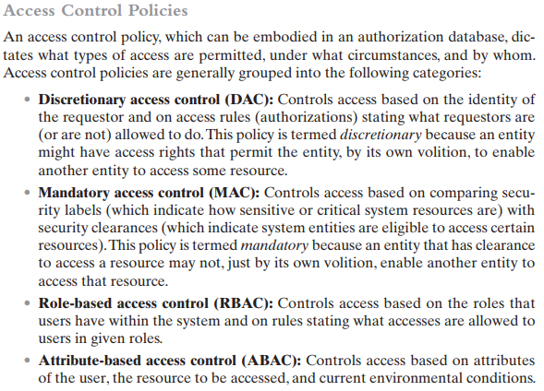

Slide 8
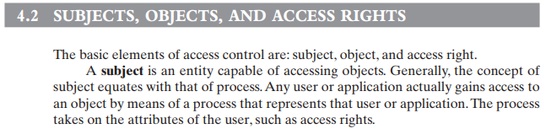
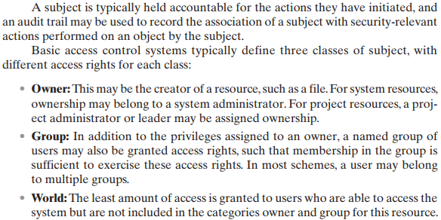

Slide 9
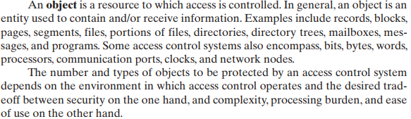

Slide 10
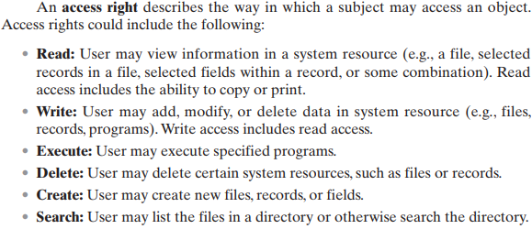

Slide 11
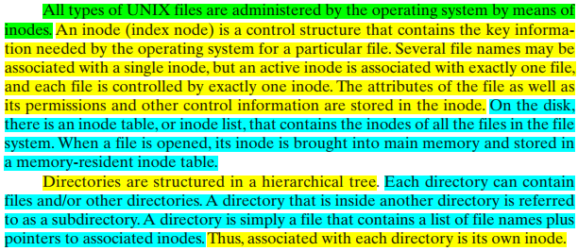

Slide 12
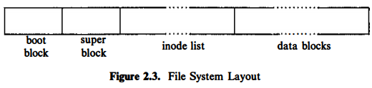
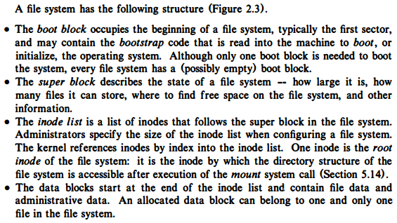

Slide 13
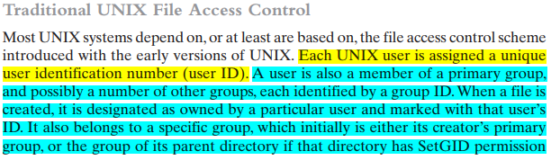
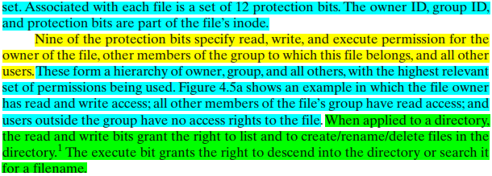

Slide 14
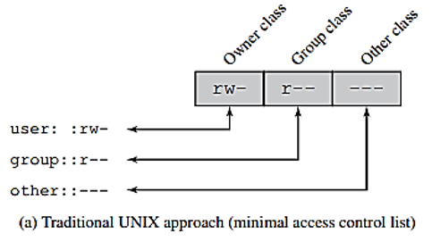
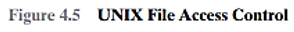
Note that the permissions that apply to a directory are distinct from those that apply to any file or directory it contains. The fact that a user has the right to write to the directory does not give the user the right to write to a file in that directory. That is governed by the permissions of the specific file. The user would, however, have the right to rename the file.

Slide 15
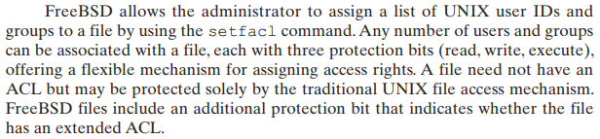
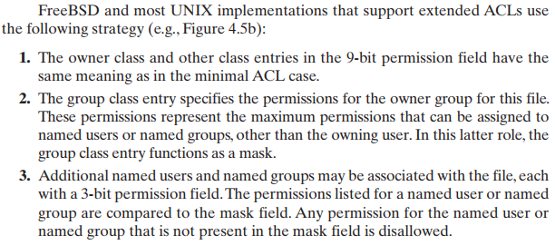
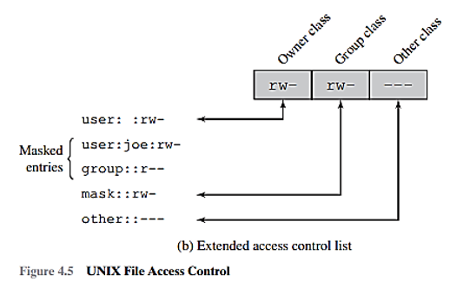
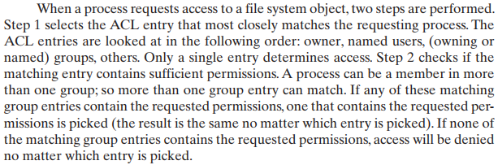

Slide 16
Role Based Access Control (RBAC)
Definition
RBAC block diagram
RBAC₀ – Base Model
RBAC supports three well-known security principles.
Case Study: RBAC for a Bank
Attribute Based Access Control
Definition
ABAC Logical Architecture
Three Key attributes of ABAC Model
ABAC Policy Model
Online Entertainment Store Scenario
Specifying a RBAC Model
Specifying a ABAC Model
Comparing RBAC and ABAC models for the scenario

Slide 17
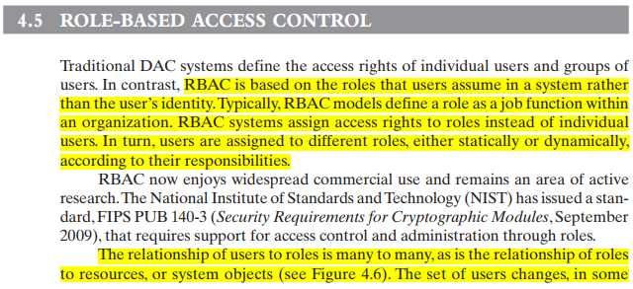
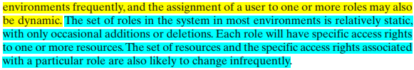

Slide 18
What is RBAC?
Role-Based Access Control Model is a nondiscretionary access control mechanism which allows & prompts the central administration of an organization specific security policy
Permission to perform an operation on an object is assigned to roles, not to users
Users are assigned to roles
Users acquire their permissions based on the roles they are assigned

Slide 19






Basic RBAC Illustrated
Users
Roles
Permissions (Objects)
Relations:
Role 1
User
Assignment (UA)
Role 2
Permission Assignment (PA)
Role 3

Slide 20
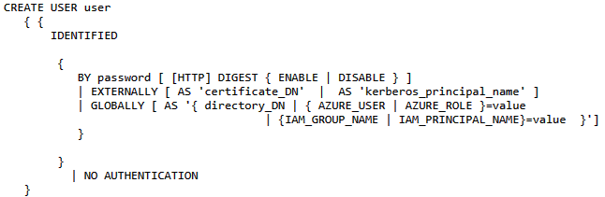
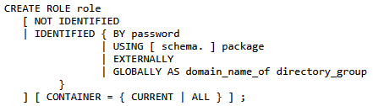
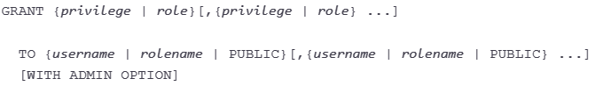
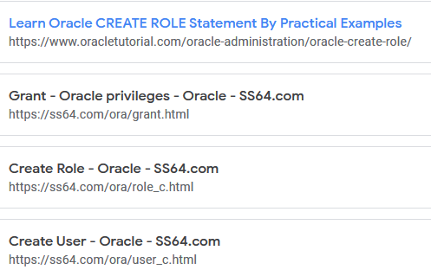
See Week # 7 materials for these links

Slide 21
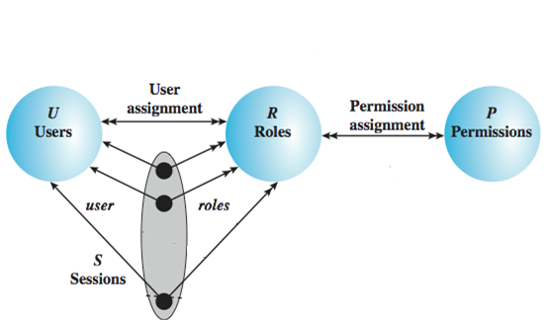
RBAC₀ – Base Model
Users: individuals with access to the system
Role: named job function within the org
Permission: approval of a particular mode of access to objects
Session: mapping between a user and a subset of roles
Notes:
Session example: UAC in Windows

Slide 22
Role-Based Access Control
RBAC supports three well-known security principles:
Least Privilege
Separation of duties
Data Abstraction
Least Privilege says that only minimum necessary rights should be assigned to a subject that requests access to a resource.
Separation of duties is achieved by ensuring that mutually exclusive roles must be invoked to complete a sensitive task.
Data abstraction is supported by means of abstract permissions such as credit and debit for an account.
The degree to which data abstraction is supported will be determined by the implementation details

Slide 23
Advantage of RBAC
Once implemented RBAC simplifies system administration
Strong support for separation of duties
Good auditing support
Considered best practice by many

Slide 24
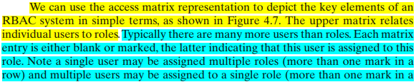
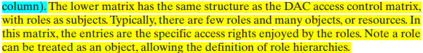
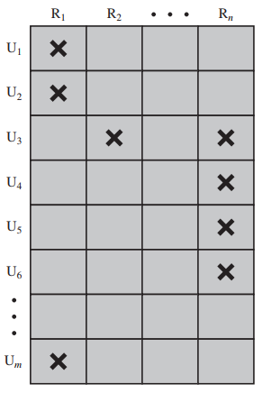
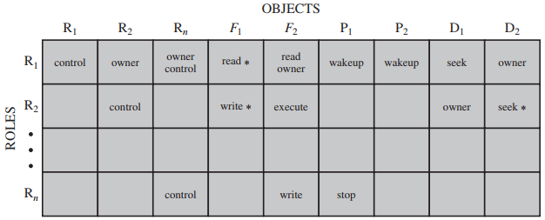
Each role should contain the minimum set of access rights needed for that role. A user is assigned to a role that enables him or her to perform only what is required for that role. Multiple users assigned to the same role enjoy the same minimal set of access rights.

Slide 25
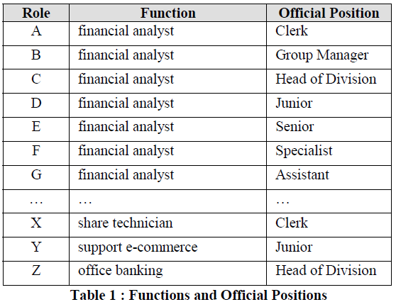
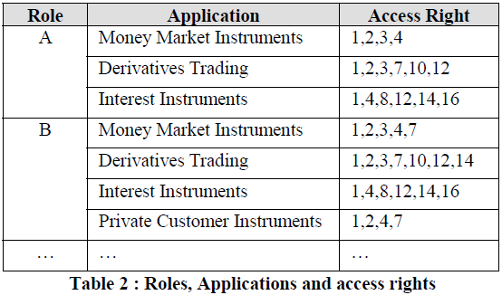
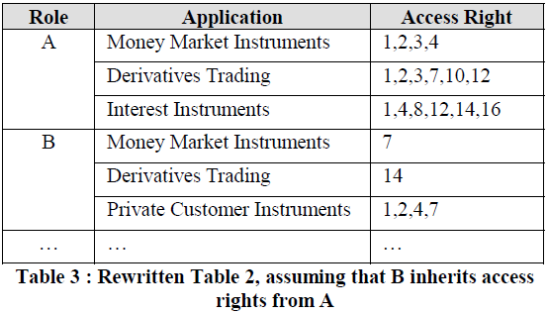
Case Study: RBAC for a Bank

Slide 26
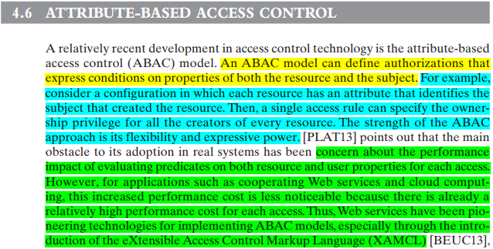
(ABAC)

Slide 27
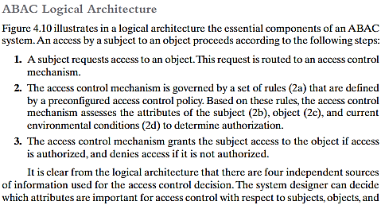
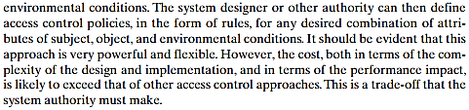

Slide 28
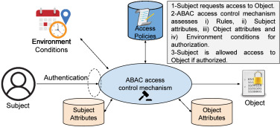
There are three key elements to an ABAC model: attributes, which are defined for entities in a configuration; a policy model, which defines the ABAC policies; and the architecture model, which applies to policies that enforce access control.
https://www.sciencedirect.com/science/article/pii/S0167739X22000115

Slide 29
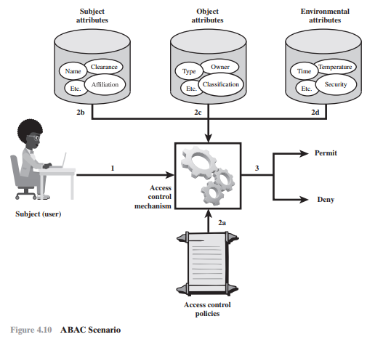
ABAC is a logical access control model that is distinguishable because it controls access to objects by evaluating rules against the attributes of entities (subject and object), operations, and the environment relevant to a request.
ABAC relies upon the evaluation of attributes of the subject, attributes of the object, and a formal relationship or access control rule defining the allowable operations for subject object attribute combinations in a given environment.
All ABAC solutions contain these basic core capabilities to evaluate attributes and enforce rules or relationships between those attributes.

Slide 30
ABAC Model
ABAC enables fine-grained access control, which allows for a higher number of discrete inputs into an access control decision, providing a bigger set of possible combinations of those variables to reflect a larger and more definitive set of possible rules, policies, or restrictions on access.
ABAC allows an unlimited number of attributes to be combined to satisfy any access control rule.
ABAC systems can be implemented to satisfy a wide array of requirements from basic access control lists through advanced expressive policy models that fully leverage the flexibility of ABAC.
ABAC systems are capable of enforcing DAC, RBAC, and MAC concepts.

Slide 31
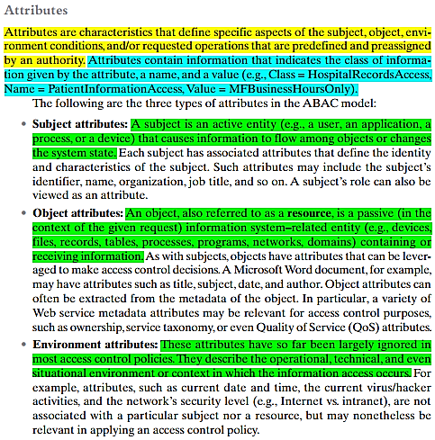
There are three key elements to an ABAC model:
attributes, which are defined for entities in a configuration;
a policy model, which defines the ABAC policies; and the
architecture model, which applies to policies that enforce access control.

Slide 32
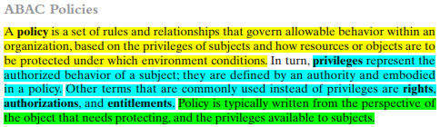

Slide 33
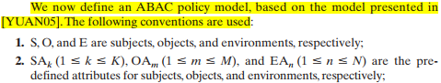
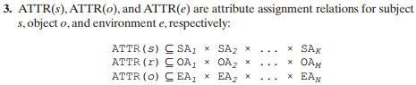
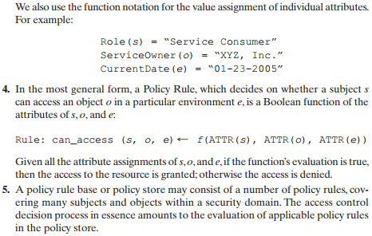

Slide 34
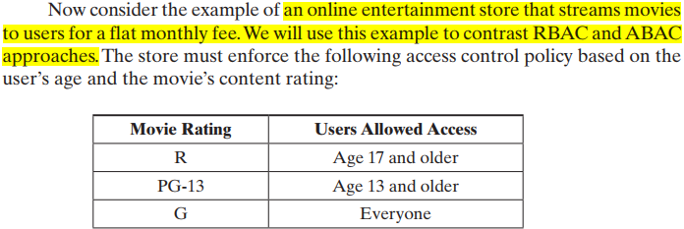
Online Entertainment Store Scenario (RBAC vs ABAC)

Slide 35
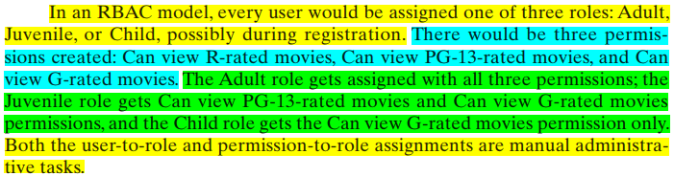
Online Entertainment Store Scenario (RBAC)

Slide 36
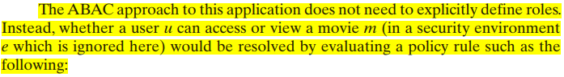


Online Entertainment Store Scenario (ABAC)

Slide 37


Online Entertainment Store Scenario (RBAC vs ABAC)
Question. Suppose movies are classified as either New Release or Old Release, based on release date compared to the current date, and users are classified as Premium User and Regular User, based on the fee they pay. Question: To enforce a policy that only premium users can view new movies, show RBAC and ABAC solutions.
RBAC model: we would have to double the number of roles, to distinguish each user by age and fee, and we would have to double the number of separate permissions as well. In general, if there are K subject attributes and M object attributes, and if for each attribute, Range() denotes the range of possible values it can take, then the respective number of roles and permissions required for an RBAC model are:
Thus, we can see that as the number of attributes increases to accommodate finer-grained policies, the number of roles and permissions grows exponentially.

Slide 38

Online Entertainment Store Scenario (RBAC vs ABAC)
ABAC model: deals with additional attributes in an efficient way. For this example, the policy R1 defined previously still applies. We need two new rules:
We can also add environmental attributes as follows:
Suppose we wish to add a new policy rule that is expressed in words as follows: Regular users are allowed to view new releases in promotional periods. we only need to add a conjunctive (AND) rule that checks to see the environmental attribute today’s date falls in a promotional period.
This would be difficult to express in an RBAC model.

Slide 39

Self Study

Slide 40
Database Access Control (Section 5.6)
Grant command
Revoke command
Discretionary vs Role-based Access control in databases
Fixed Roles in Microsoft SQL Server
Cascading Authorizations
Disclosure of database information through Inference (Section 5.7)
Understanding Inference
Case for Inference: Employee Schema

Slide 41


Slide 42




Slide 43


Slide 44

A role-based access control (RBAC) scheme is a natural fit for database access control.
Unlike a file system associated with a single or a few applications, a database system often supports dozens of applications.
In such an environment, an individual user may use a variety of applications to perform a variety of tasks, each of which requires its own set of privileges.
It would be poor administrative practice to simply grant users all of the access rights they require for all the tasks they perform.
RBAC provides a means of easing the administrative burden and improving security.

Slide 45


Slide 46


Suppose Bob revokes the privilege from David. David still has the access right because it was granted by Chris at t = 50.
The access rights to Ellen and Jim is revoked when Bob revokes the access right to David.
Why? This is because at t = 40, when David granted the access right to Ellen, David only had the grant option to do this from Bob. When Bob revokes the right, this causes all subsequent cascaded grants that are traceable solely to Bob via David to be revoked.

Slide 47


Metadata refers to knowledge about correlations or dependencies among data items that can be used to deduce information not otherwise available to a particular user.
Inference, as it relates to database security, is the process of performing authorized queries and deducing unauthorized information from the legitimate responses received.
The inference problem arises when the combination of a number of data items is more sensitive than the individual items, or when a combination of data items can be used to infer data of higher sensitivity.
Figure 5.7 illustrates the process. The attacker may make use of non sensitive data as well as metadata. The information transfer path by which unauthorized data is obtained is referred to as an inference channel.
Two inference techniques can be used to derive additional information:
Analyzing functional dependencies between attributes within a table or across tables, and
Merging views with the same constraints.

Slide 48



A user who knows the structure of the Inventory table and who knows that the view tables maintain the same row order as the Inventory table is then able to merge the two views to construct the table shown in Figure 5.8c. This violates the access control policy that the relationship of attributes Item and Cost must not be disclosed.

Slide 49

How to dead with the threat of disclosure by inference?

Slide 50

Consider a database containing personnel information, including names, addresses, and salaries of employees. Individually, the name, address, and salary information is available to a subordinate role, such as Clerk, but the association of names and salaries is restricted to a superior role, such as Administrator.
Create a small database schema to hold the above information. How we safeguard against inference?
In which table a new attribute, employee start date could be added if it is not sensitive?

Slide 51

Consider a database containing personnel information, including names, addresses, and salaries of employees. Individually, the name, address, and salary information is available to a subordinate role, such as Clerk, but the association of names and salaries is restricted to a superior role, such as Administrator.
In which table a new attribute, employee start date could be added if it is not sensitive?

Slide 52
Database Encryption (Section 5.7)
Actors in a Database Encryption Scheme
Whole Database Encryption Scheme (Figure 5.9)
Row Encryption Scheme (Figure 5.10, Table 5.3)
How row-wise encryption scheme works?
Performance and other improvements

Slide 53

Encryption becomes the last line of defense in database security.
Encryption can be applied to the (i) entire database, (ii) at the record level (encrypt selected records), (iii) at the attribute level (encrypt selected columns), or at the level of the individual field.

Slide 54

Actors in a Database Encryption Scheme

Slide 55


Slide 56



1.
Assume the encryption key k is used and the encrypted value of the department id 15 is E(k, 15) = 1000110111001110.
2.
3.
If the user wishes to retrieve all records for salaries less than $70K. There is no obvious way to do this, because the attribute value for salary in each record is encrypted. The set of encrypted values do not preserve the ordering of values in the original attribute.
4.

Slide 57


Alternate Approach (1)
Each row Ri is treated as a contiguous block forming a sequence of bits, and all of the attribute values for that row are concatenated together to form a single binary block.
The entire row is encrypted.
Shown as I_{i1}, I_{i2}, I_{i3}, … are indexes are associated with each attribute of the table.

Slide 58
Alternate Approach (2)
Suppose employee ID (eid) values lie in the range [1, 1000].
We can divide these values into five partitions: [1, 200], [201, 400], [401, 600], [601, 800], and [801, 1000]; then assign index values 1,2, 3, 4, and 5, respectively.
23 → partition 1
860 → partition 5
320 → partition 2
875 → partition 5

Slide 59
Alternate Approach (3)
This arrangement provides for more efficient data retrieval. Suppose, for example, a user requests records for all employees with eid < 300.
The query processor requests all records with I(eid) = 2.
These are returned by the server.
The query processor decrypts all rows returned, discards those that do not match the original query, and returns the requested unencrypted data to the user.
The indexing scheme just described does provide a certain amount of information to an attacker, namely a rough relative ordering of rows by a given attribute. To obscure such information, the ordering of indexes can be randomized.
For example, the eid values could be partitioned by mapping [1, 200], [201, 400], [401, 600], [601, 800], and [801, 1000] into 2, 3, 5, 1, and 4, respectively. Because the metadata are not stored at the server, an attacker could not gain this information from the server.

Slide 60
Alternate Approach (4)
To increase the efficiency of accessing records by means of the primary key, the system could use the encrypted value of the primary key attribute values, or a hash value.
In either case, the row corresponding to the primary key value could be retrieved individually.
Different portions of the database could be encrypted with different keys, so users would only have access to that portion of the database for which they had the decryption key.
This latter scheme could be incorporated into a role-based access control system.

